Slide 1
Maths Daily Practice
Grade 1 - Week 6
Complete this work in a notebook at home. This is not mandatory homework.
Therefore, it does not need bringing into school. This is optional practice to support the learning taking place in school.

Slide 2
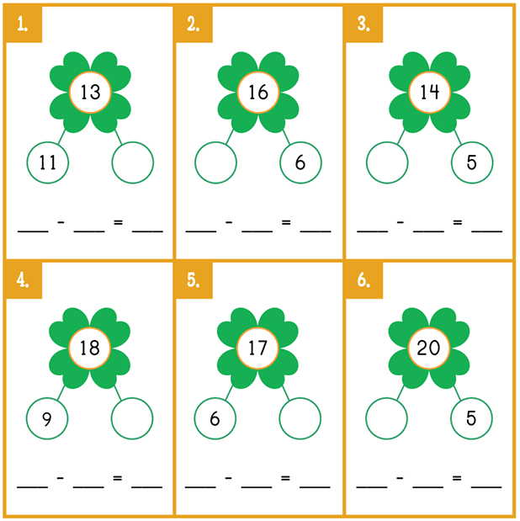
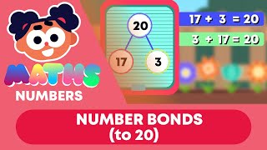
Daily practice 1
Number Bonds up to 20
Complete the part-whole models by writing the correct numbers in the spaces. Then, write the sum.

Slide 3
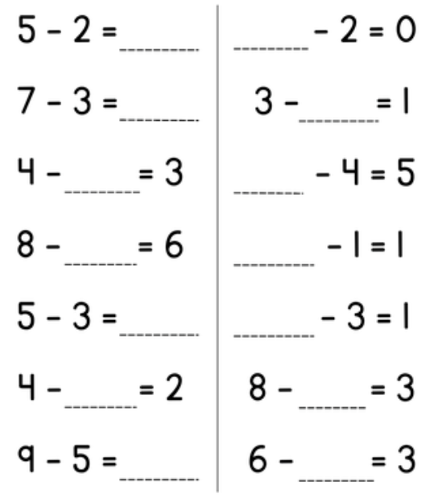
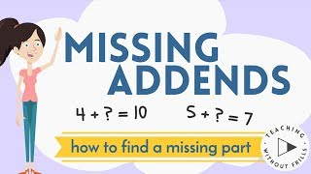
Daily practice 2
Missing Number
Subtraction

Slide 4

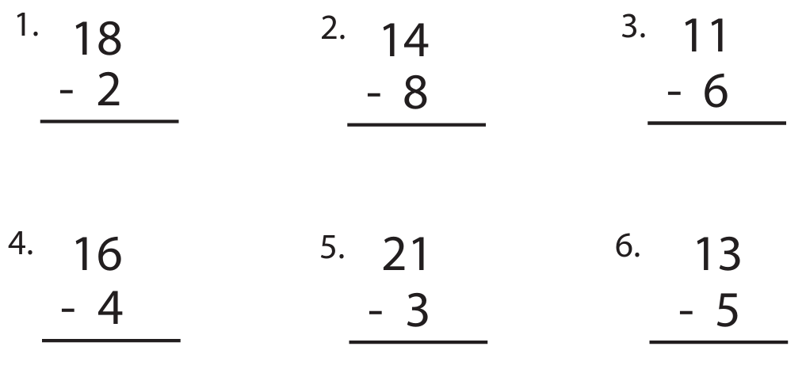
Daily practice 3
Column Subtraction

Slide 5
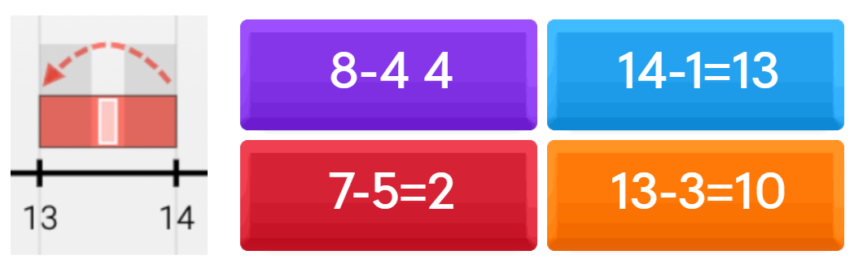
Daily practice 4
Subtraction on a number line - Quiz
Subtraction on the Number Line - Quiz

Slide 6
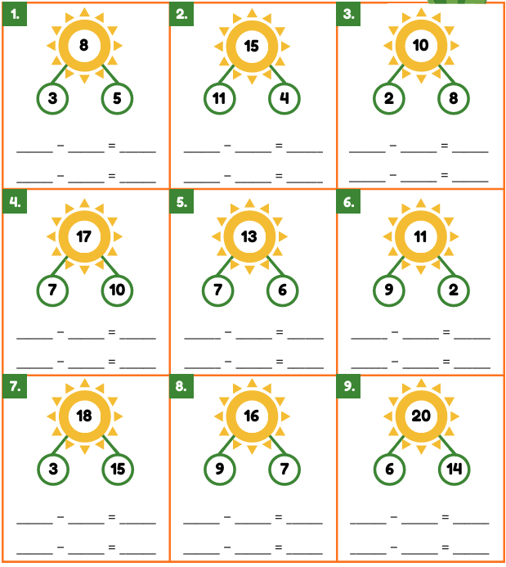
Daily practice 5
Subtraction
Each part-whole model has two subtraction sentences.
Write both subtraction sums for these part-whole models.

